Slide 1


Data Visualization – Starbucks vs Dunkin Donuts Analysis
Presenters: Nella Granback
Belinda Marshall
Ang Li
Pete Chan

Slide 2
Data Visualization – Starbucks vs Dunkin Donuts Analysis
Introduction
Data
Visualization

Slide 3
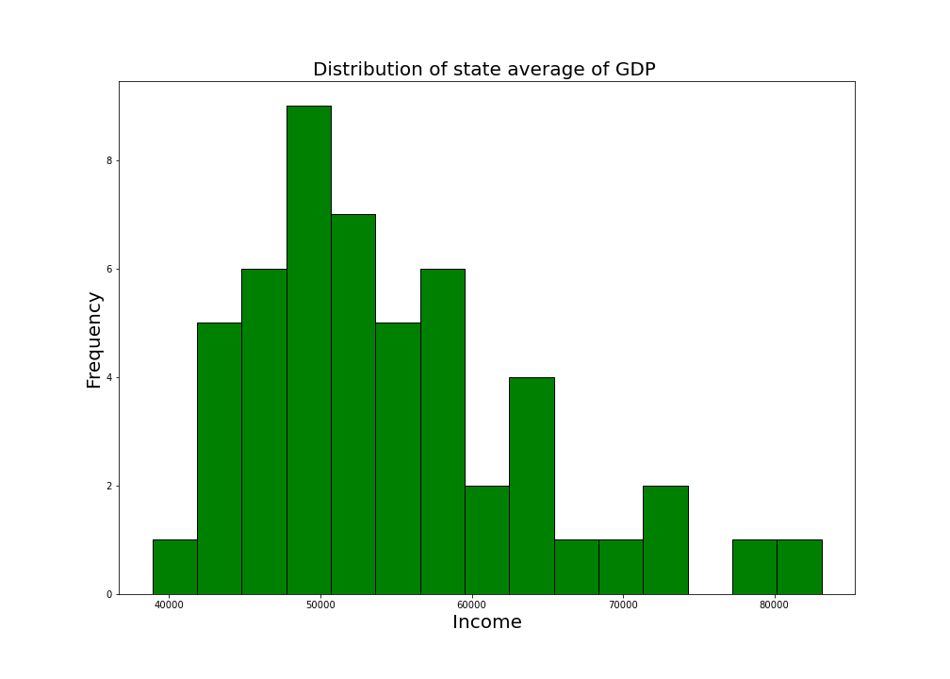
Data Visualization – Starbucks vs Dunkin Donuts Analysis
Histogram of Income vs Frequency

Slide 4
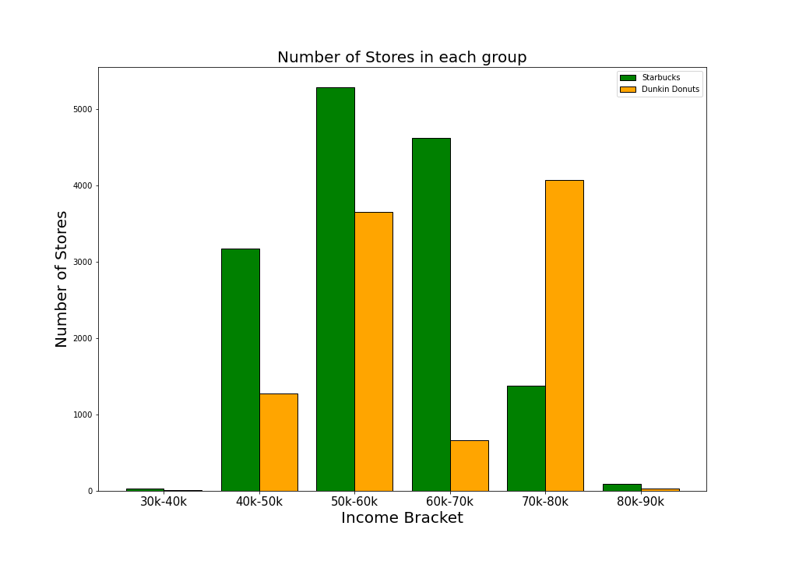
Data Visualization – Starbucks vs Dunkin Donuts Analysis
Combined Bar - Store Count vs Income Bracket

Slide 5
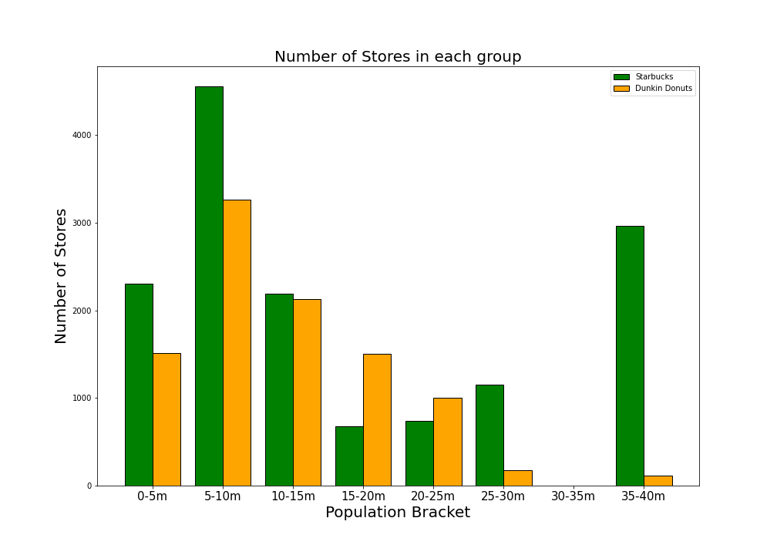
Data Visualization – Starbucks vs Dunkin Donuts Analysis
Combined Bar - Store Count vs Population Bracket

Slide 6
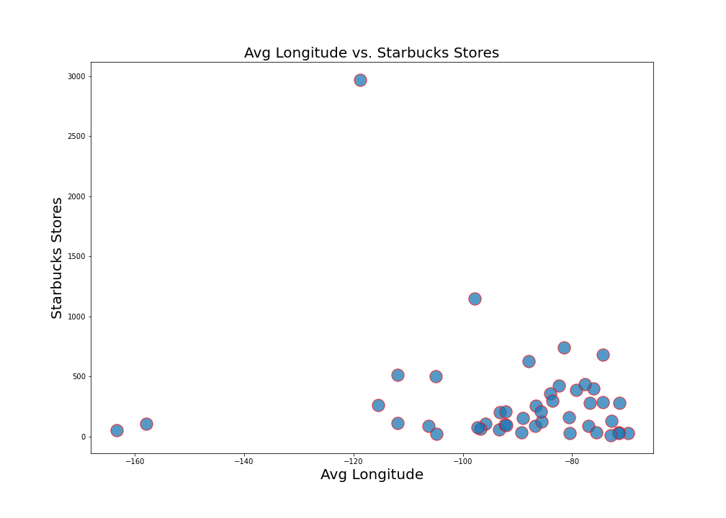
Data Visualization – Starbucks vs Dunkin Donuts Analysis
Scatterplot – Starbucks Stores vs Longitude

Slide 7
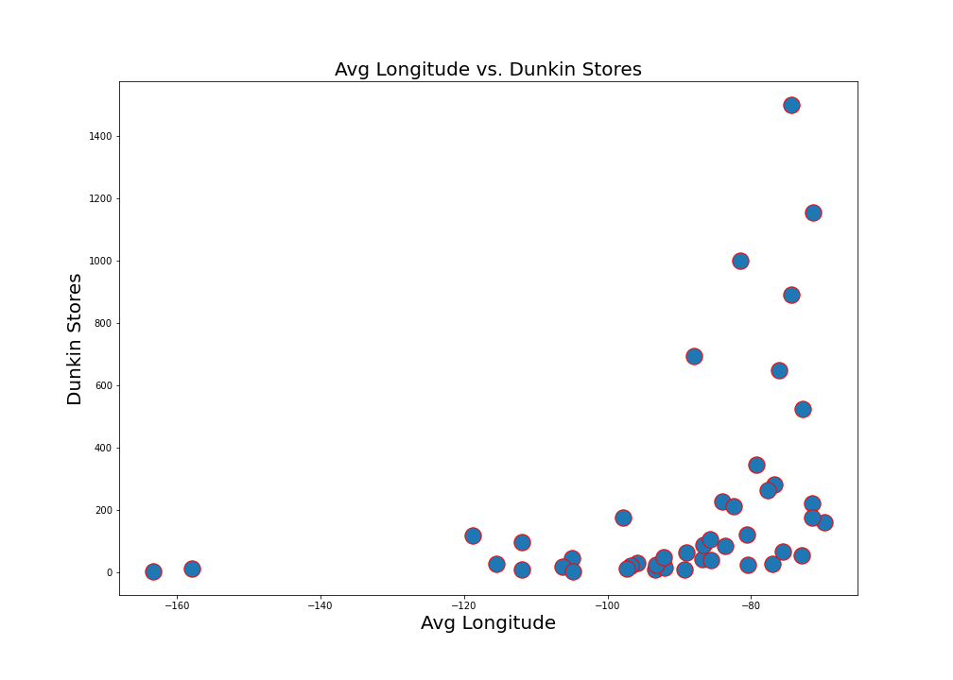
Data Visualization – Starbucks vs Dunkin Donuts Analysis
Scatterplot – Dunkin Donuts Stores vs Longitude

Slide 8
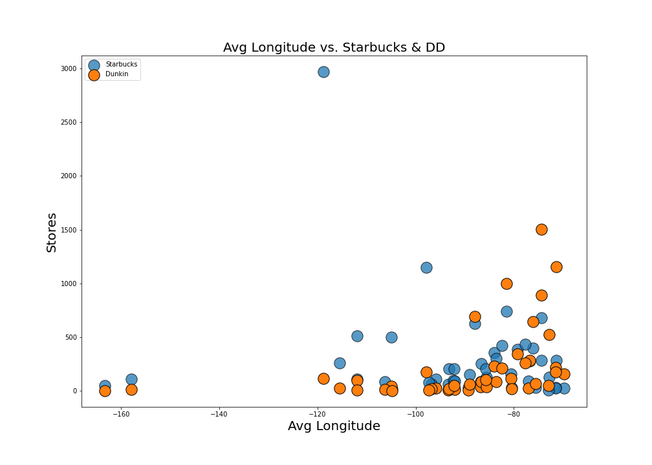
Data Visualization – Starbucks vs Dunkin Donuts Analysis
Scatterplot – Combined Store Count vs Longitude

Slide 9
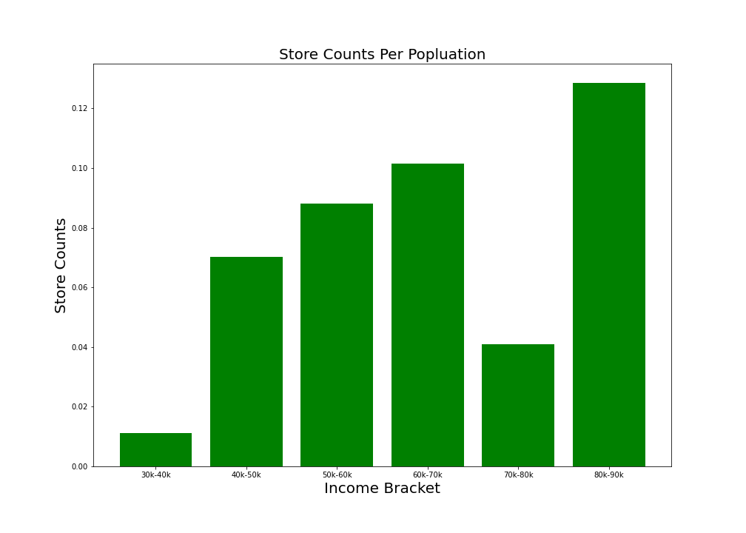
Data Visualization – Starbucks vs Dunkin Donuts Analysis
Bar – Average Number of Starbucks Stores per person vs Income Bracket

Slide 10
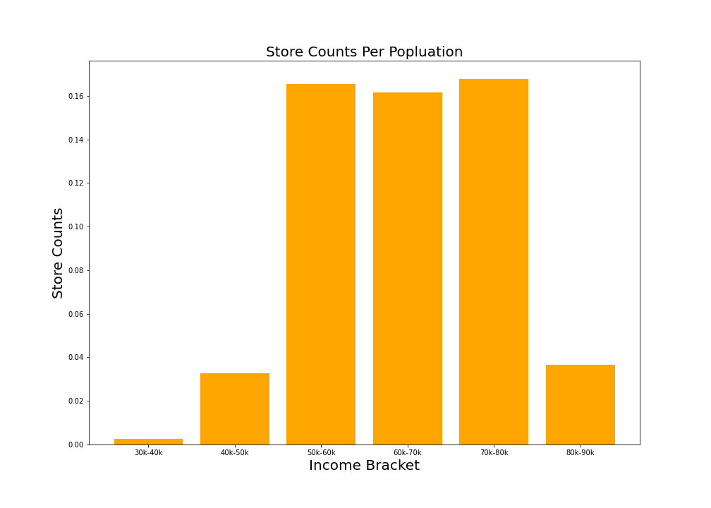
Data Visualization – Starbucks vs Dunkin Donuts Analysis
Bar – Average Number of Dunkin Donuts Stores per person vs Population Bracket

Slide 11
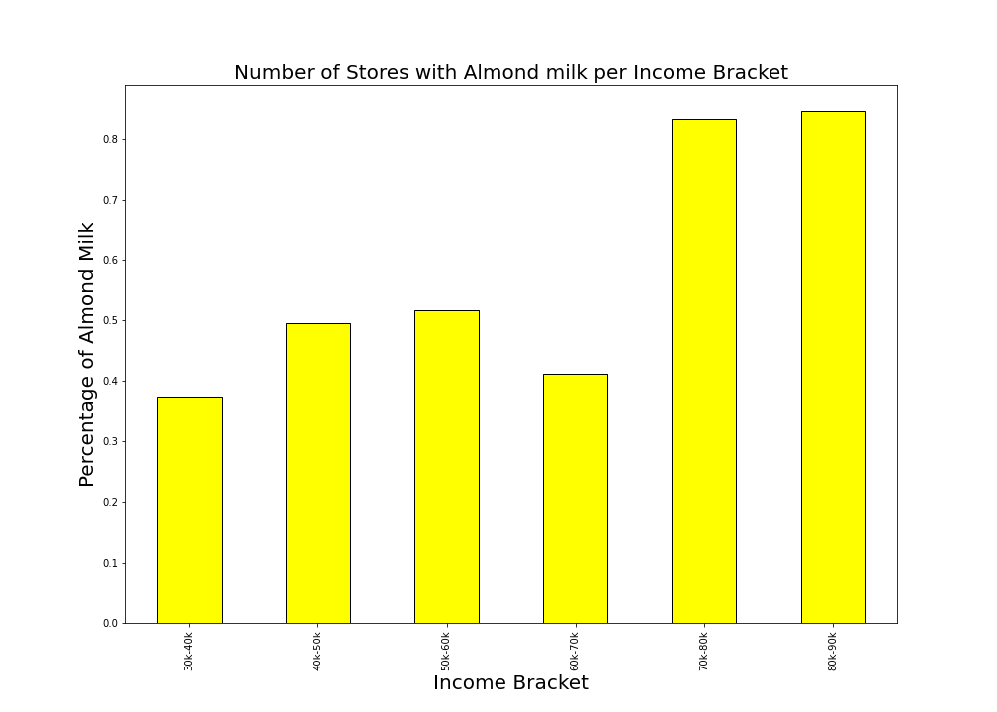
Data Visualization – Starbucks vs Dunkin Donuts Analysis
Bar – Income Bracket vs Percent of Dunkin Donuts Stores with Almond Milk

Slide 12
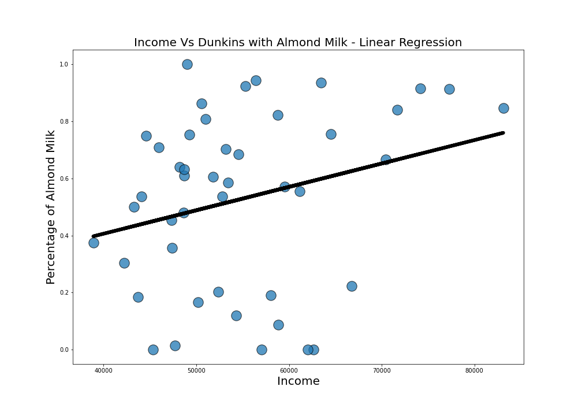
Data Visualization – Starbucks vs Dunkin Donuts Analysis
Scatterplot w/ Line – Income Bracket vs Percent of Dunkin Donuts Stores with Almond Milk

Slide 13
Data Visualization – Starbucks vs Dunkin Donuts Analysis
Questions?

